Slide 1
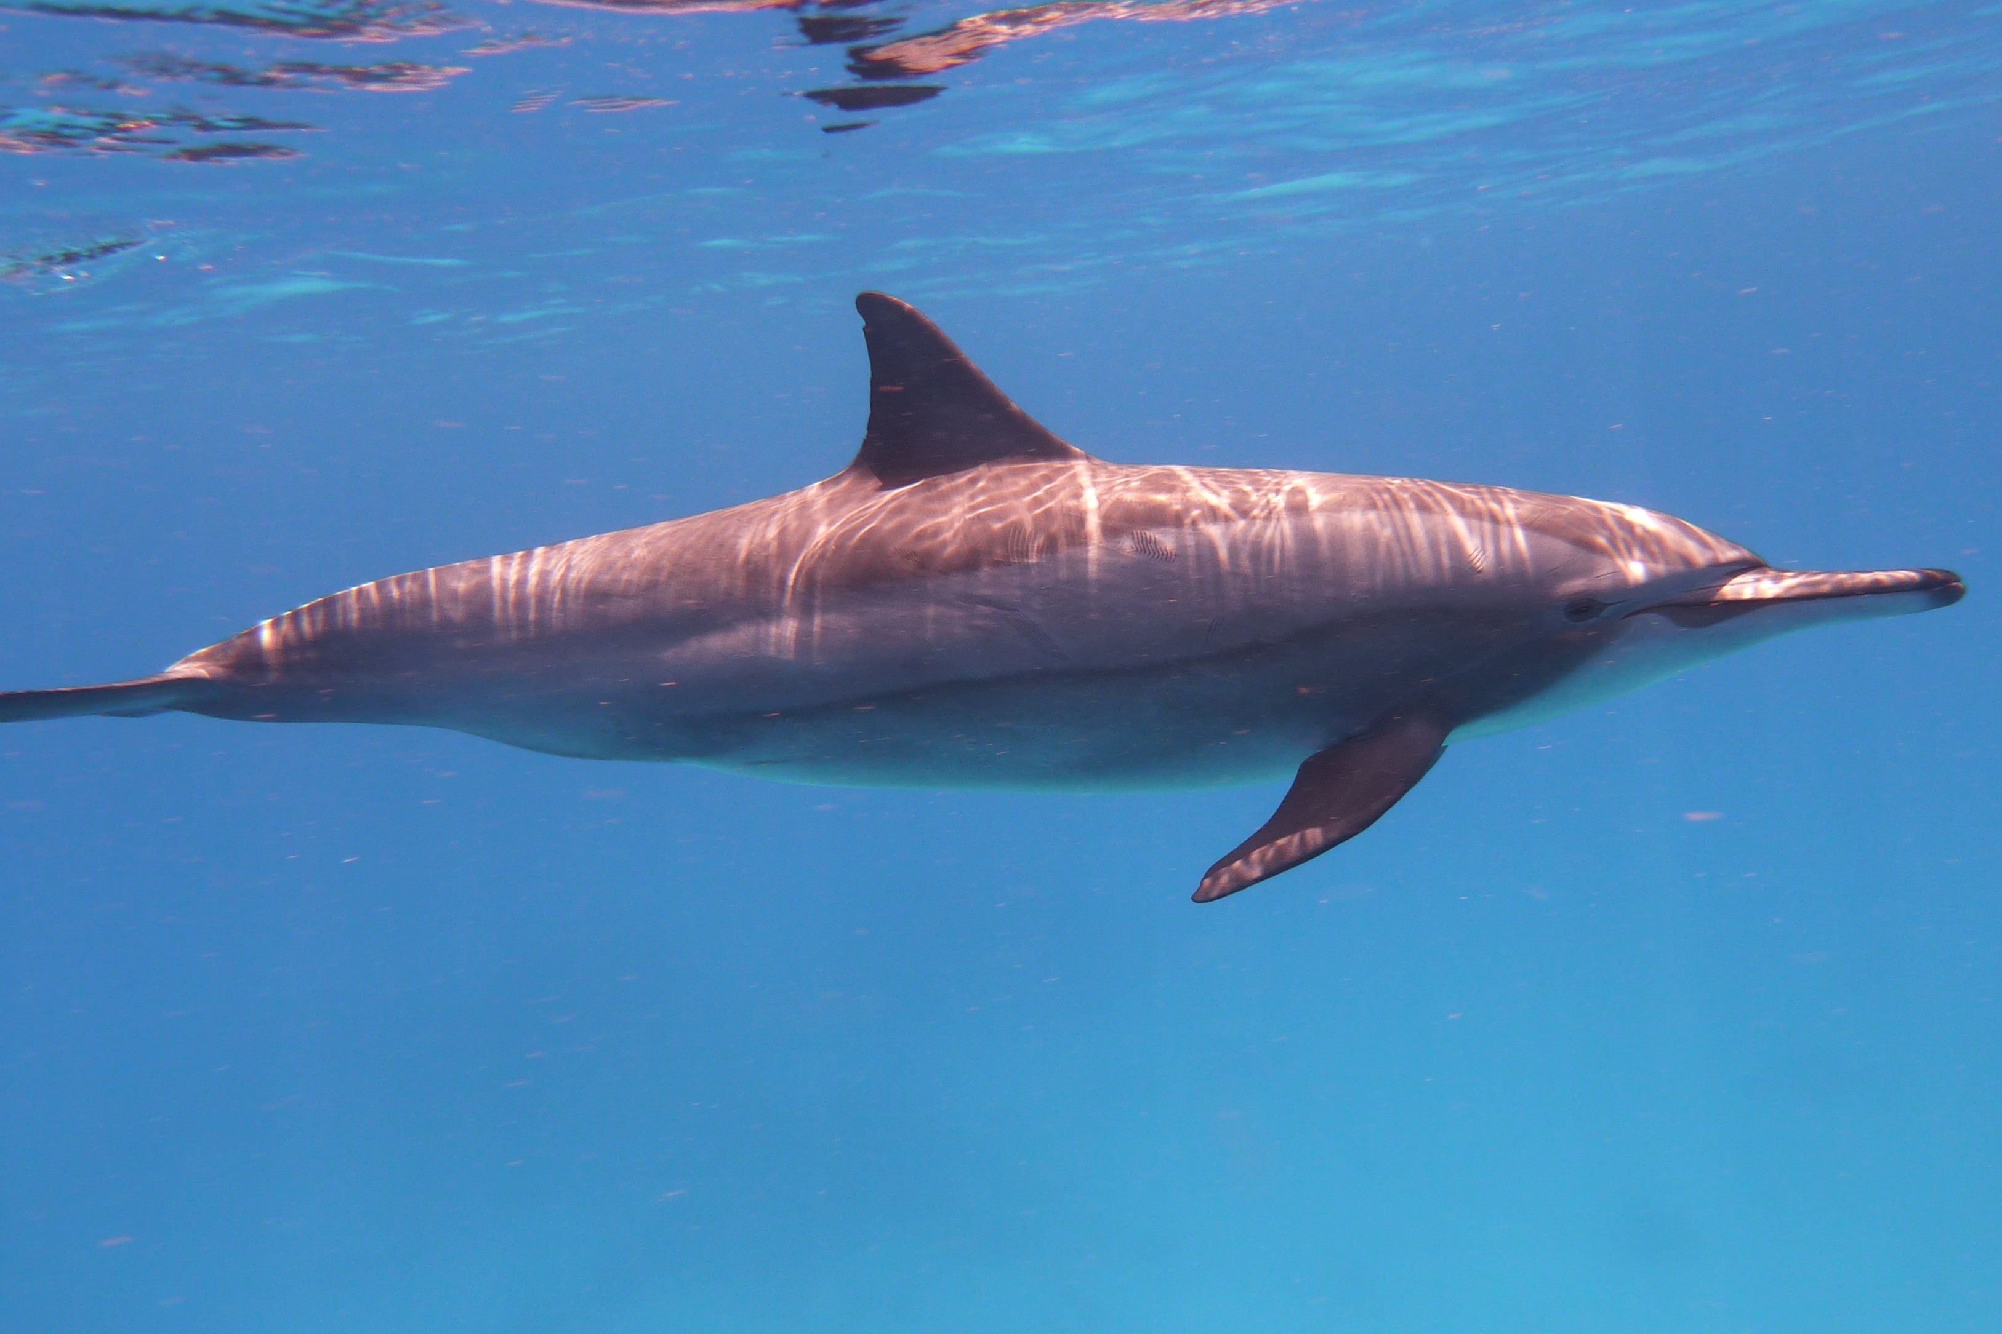
BIAI Project – Check for Whale or Dolphin
Kacper Nitkiewicz
Kamila Ertel
GKiO3

Slide 2
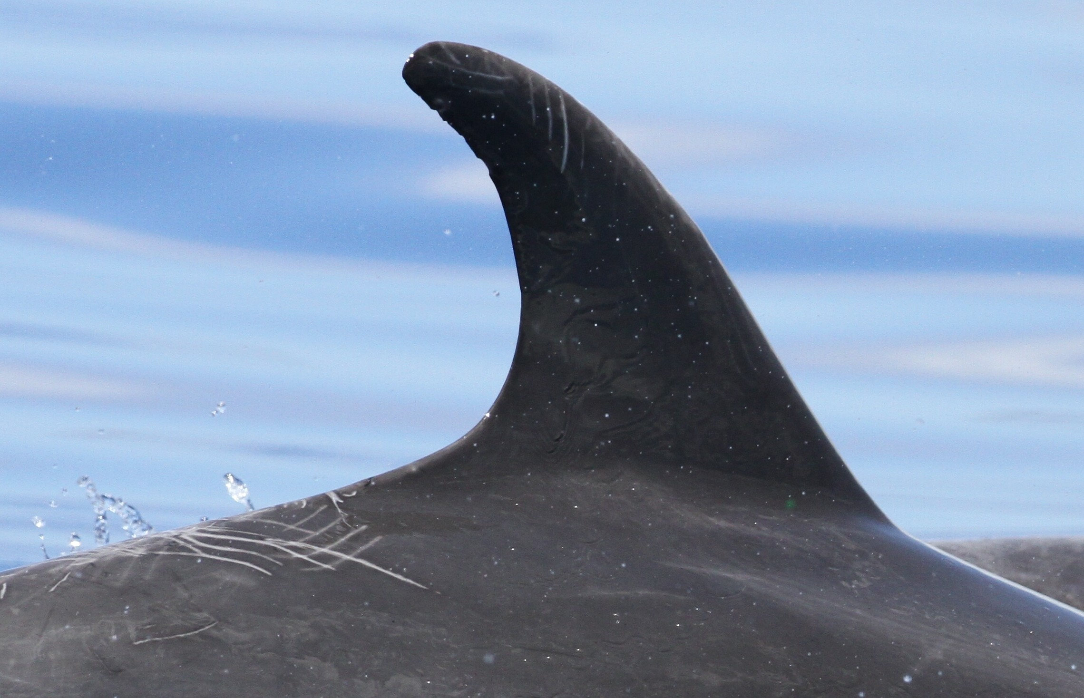
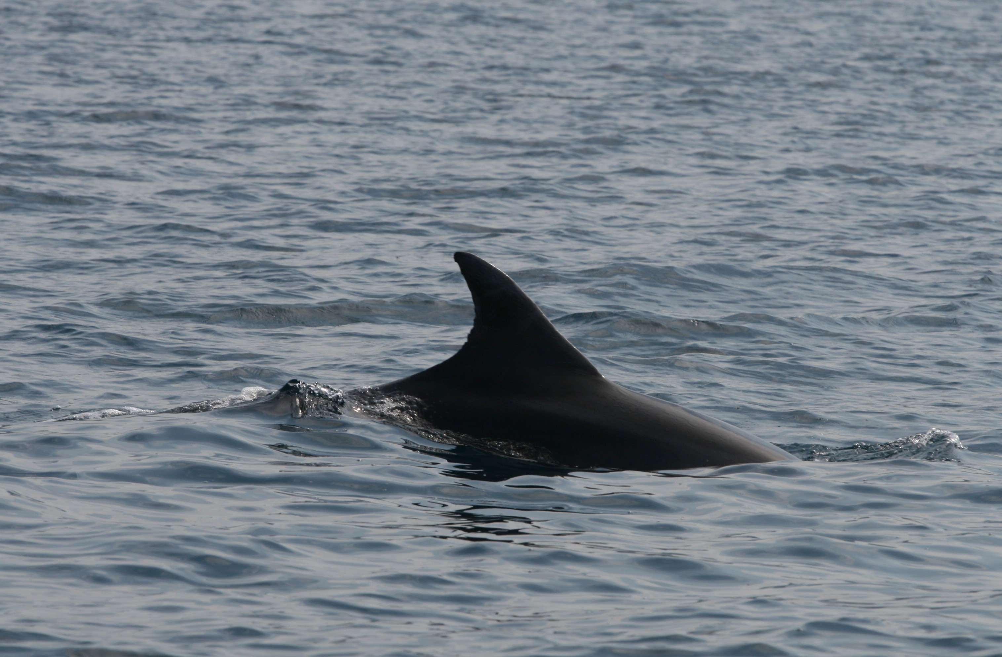
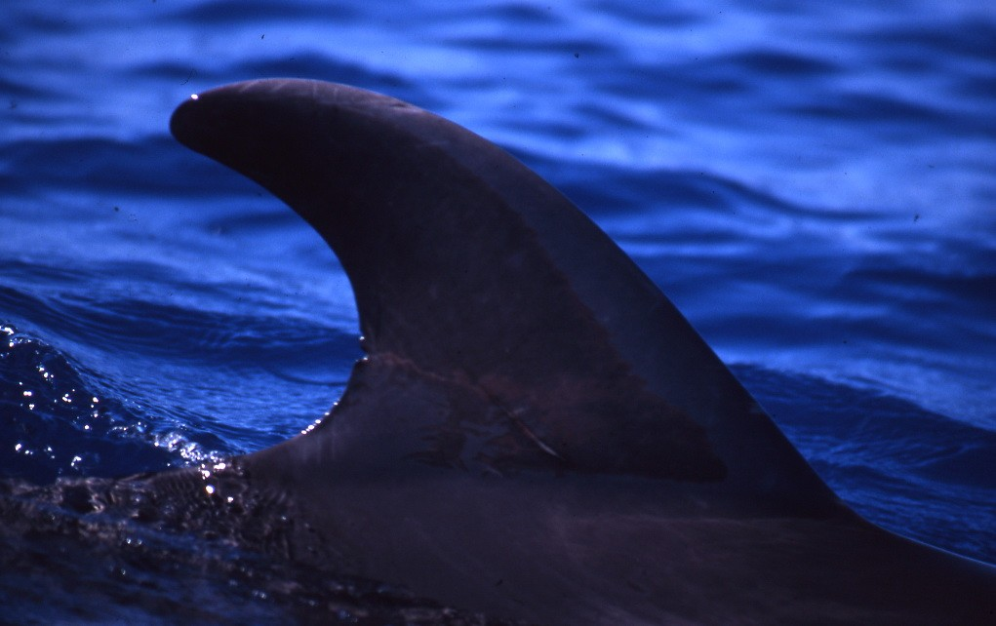
Main goal
The main goal of the project is to create a neural network model, that can recognize if there is a Dolphin or a Whale in the picture

Slide 3




Chosen software
Libraries: Tensorflow Keras Qt5
Coding language: Python

Slide 4

Decided to go with Convolutional Neural Network (CNN) mainly cause of the need to process images and find distinct features of a Dolphin or a Whale. This model lets create convolutional layers, that work like a small „window” for checking a group of pixels in search for a specific pattern and then convert it to one pixel value.
Convolutional Neural Network

Slide 5
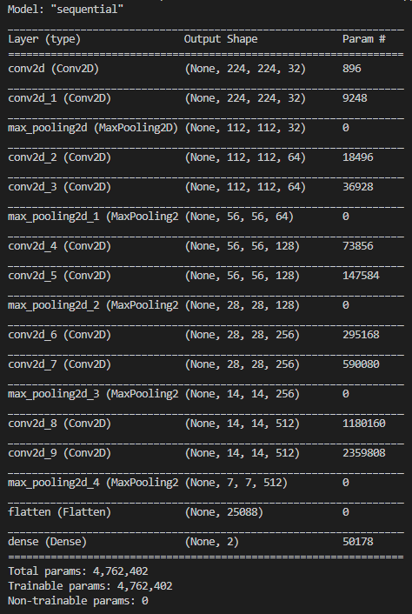
First model was inspired by VGG16 model with its sets of 2 convolutional and 1 pooling layers, but because of a big number of filters it required some time to finish training. (around 3 minutes for 1 epoch) The results were always around 65%. At first the compiled losses were done with Poisson method. It soon lost to other models.
First tested model

Slide 6
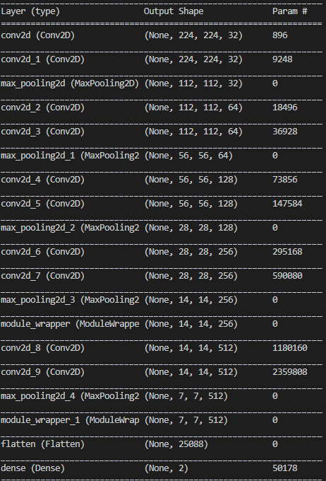
Second model was inspired by VGG16 model with its sets of 2 convolutional and 1 pooling layers. The results were always around 73%. At first the compiled losses were done by binary crossentropy. The method didn’t really work with 2 categories that we gave it. It is better to use this method if you want to define if something is or isn’t.
Second tested model

Slide 7
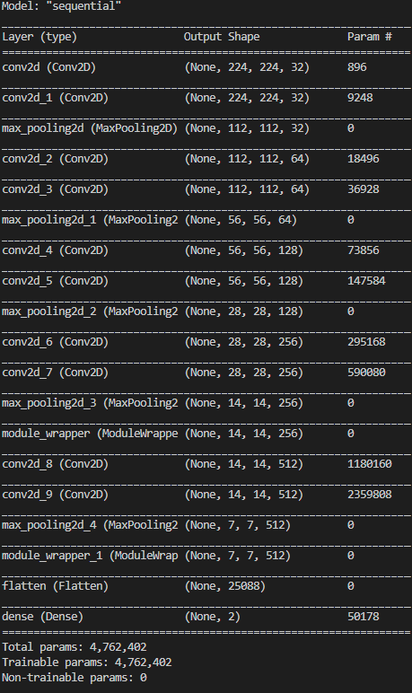
Last method that we tried focus on setting loss to kl_divergence while compiling. We also added two layers of dropout for preventing the overlearning also tweaked some filters of convolutional layers This resulted in 91.5% accuracy. Right now if we change parameters we can only see diminishing returns.
Best performing model
Convolutional layer kernel size: 3x3 Maxpooling pool size: 2x2 Maxpooling strides: 2 Dropout: 0.25

Slide 8
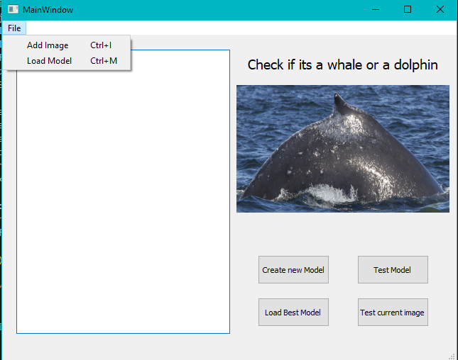
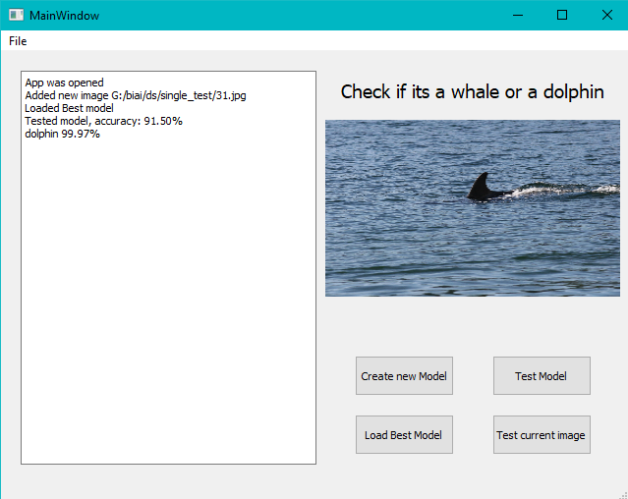

GUI
We decided to use gui from qt5 library. It was really easy to create menu with drag and drop designer and compile given .ui file to python. It resulted in beautiful application with many known features.

Slide 9
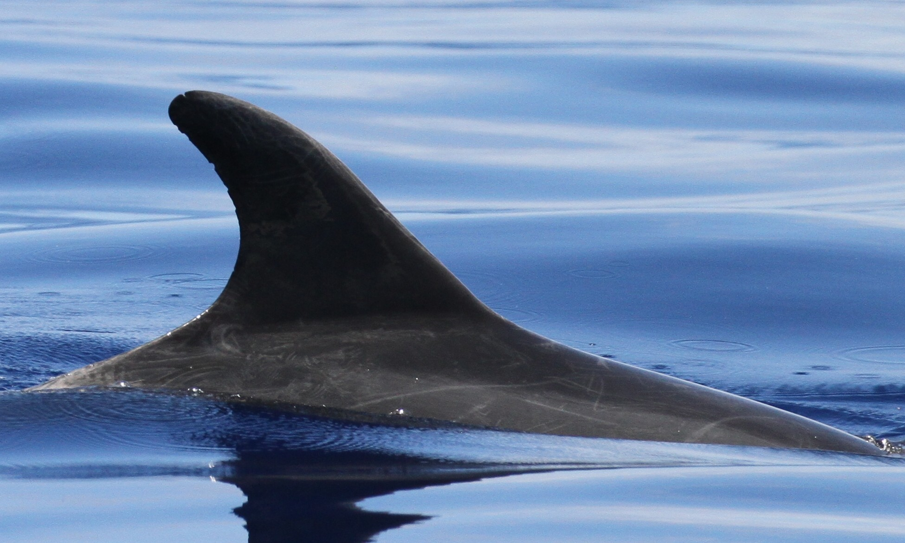
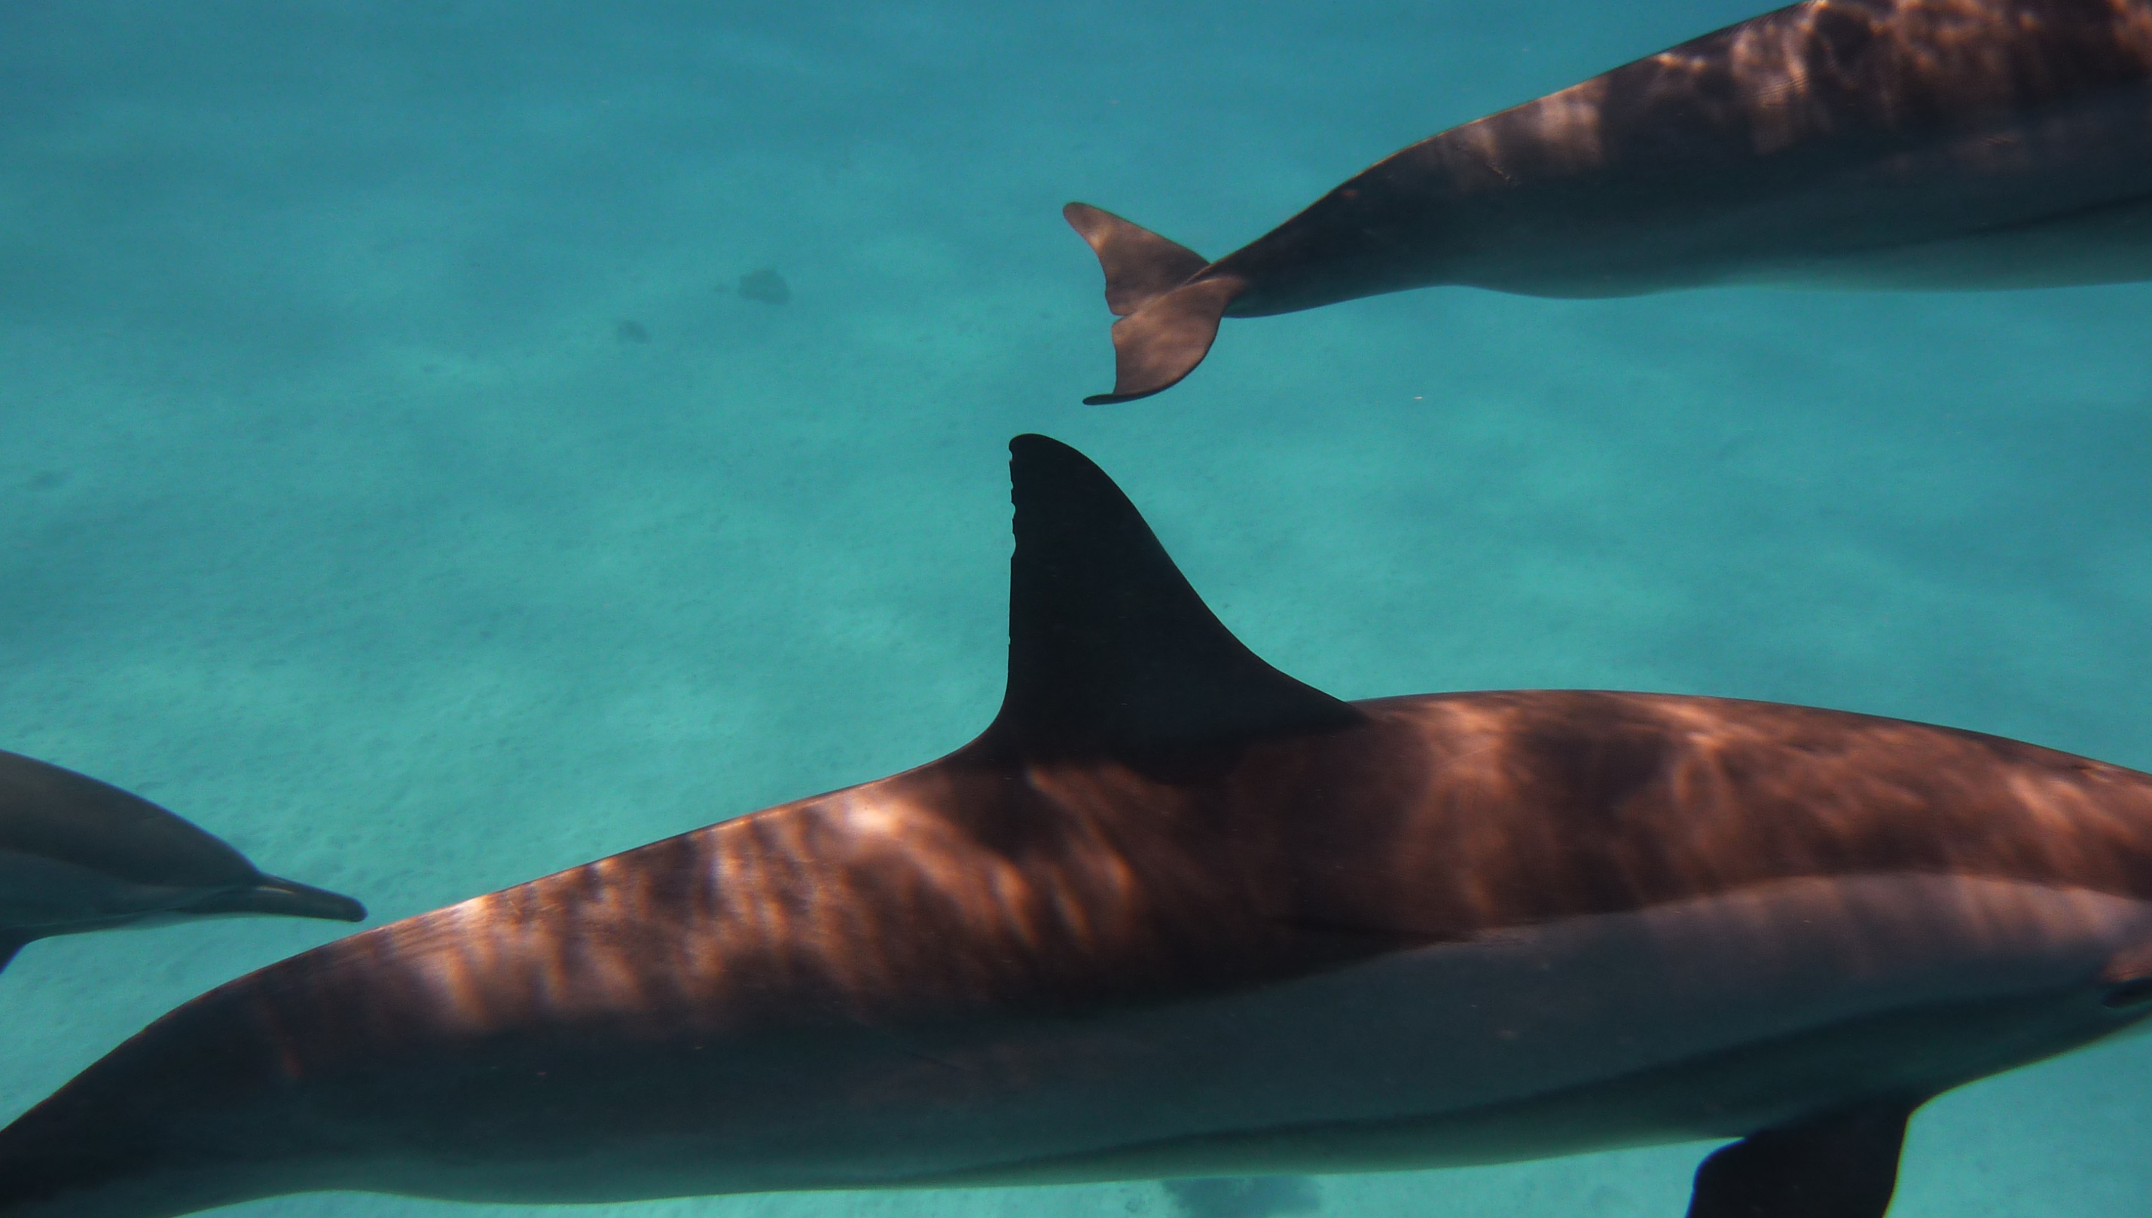
The end

